Slide 1
Free fall
Derivation of g

Slide 2
Free fall

Slide 3
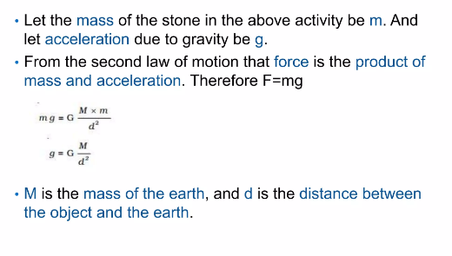
Derivation of g

Slide 4
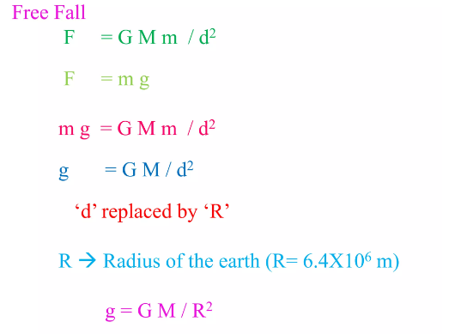
Free fall

Slide 6
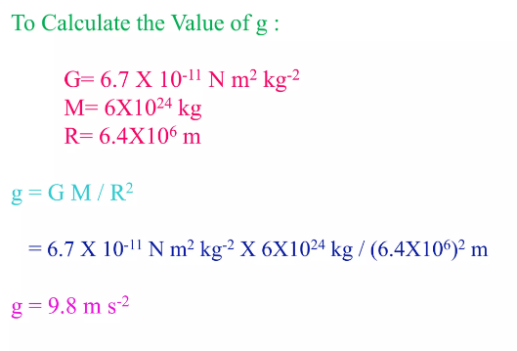
Value of g

Slide 7
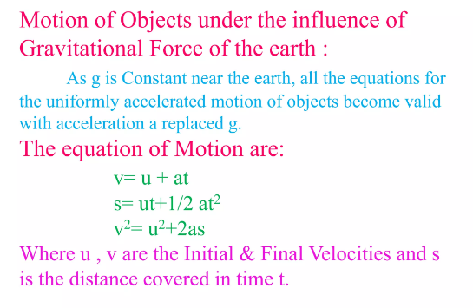
Motion of objects and g-Their relation

Slide 8
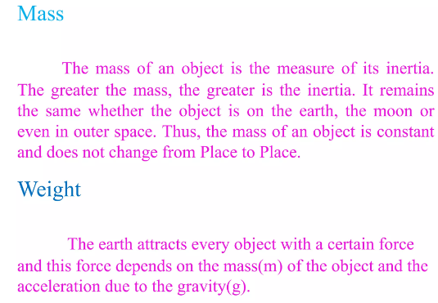
Mass and weight

Slide 9
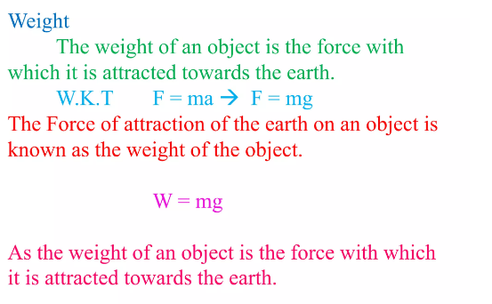
weight

Slide 10
Earth and Moon

Slide 11
